Slide 1
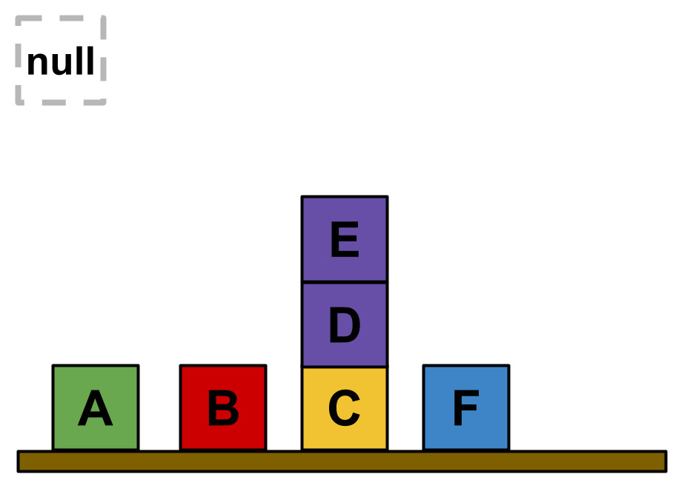
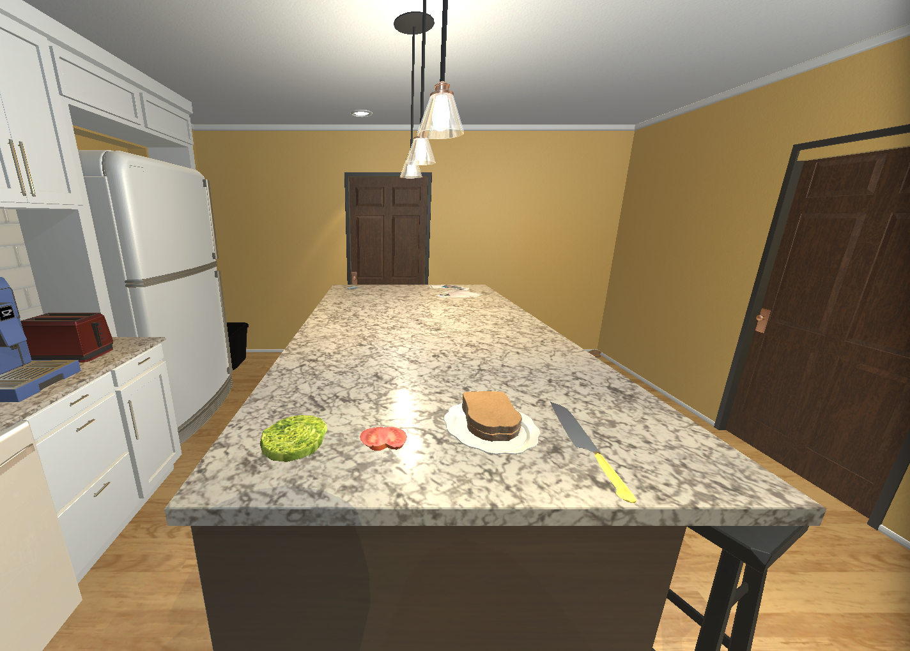
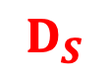
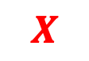
$$D_{S}$$
ColorBlocksworld
Kitchenworld
IsOnTable | block | isOnTable
1 | 2 | TRUE
2 | 3 | TRUE
3 | 4 | TRUE
4 | 5 | FALSE
5 | 6 | FALSE
6 | 7 | TRUE
IsClear | block | isClear
1 | 2 | TRUE
2 | 3 | TRUE
3 | 4 | FALSE
4 | 5 | FALSE
5 | 6 | TRUE
6 | 7 | TRUE
HasColor | block | hasColor
1 | 2 | green
2 | 3 | red
3 | 4 | yellow
4 | 5 | purple
5 | 6 | purple
6 | 7 | blue
HasLabel | block | hasLabel
1 | 1 | null
2 | 2 | A
3 | 3 | B
4 | 4 | C
5 | 5 | D
6 | 6 | E
7 | 7 | F
Empty | isEmpty
1 | 1
Gripper | isHolding
1 | 1
On | on_l | on_r
1 | 6 | 5
2 | 5 | 4
$$X$$

Slide 2
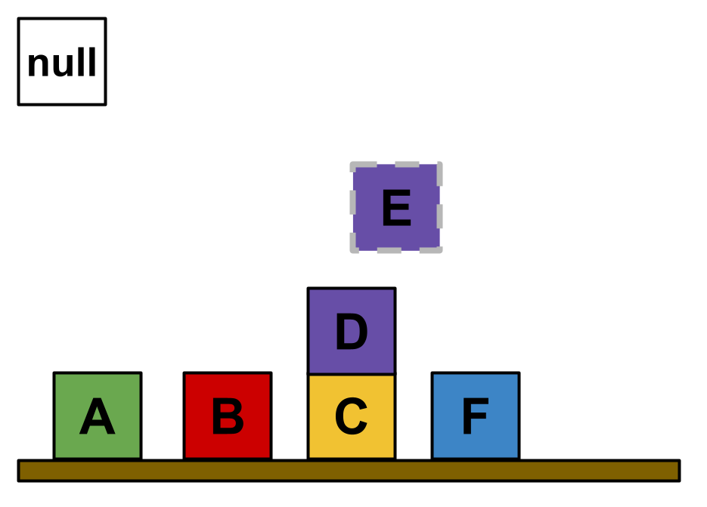
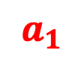
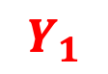
$$D_{S}$$
ColorBlocksworld
Kitchenworld
unstack E D
$$a_{1}$$
IsOnTable | block | isOnTable
1 | 2 | TRUE
2 | 3 | TRUE
3 | 4 | TRUE
4 | 5 | FALSE
5 | 6 | FALSE
6 | 7 | TRUE
IsClear | block | isClear
1 | 2 | TRUE
2 | 3 | TRUE
3 | 4 | FALSE
4 | 5 | TRUE
5 | 6 | TRUE
6 | 7 | TRUE
HasColor | block | hasColor
1 | 2 | green
2 | 3 | red
3 | 4 | yellow
4 | 5 | purple
5 | 6 | purple
6 | 7 | blue
HasLabel | block | hasLabel
1 | 1 | null
2 | 2 | A
3 | 3 | B
4 | 4 | C
5 | 5 | D
6 | 6 | E
7 | 7 | F
Empty | isEmpty
1 | 1
Gripper | isHolding
1 | 6
On | on_l | on_r
1 | 5 | 4
$$Y_{1}$$

Slide 3
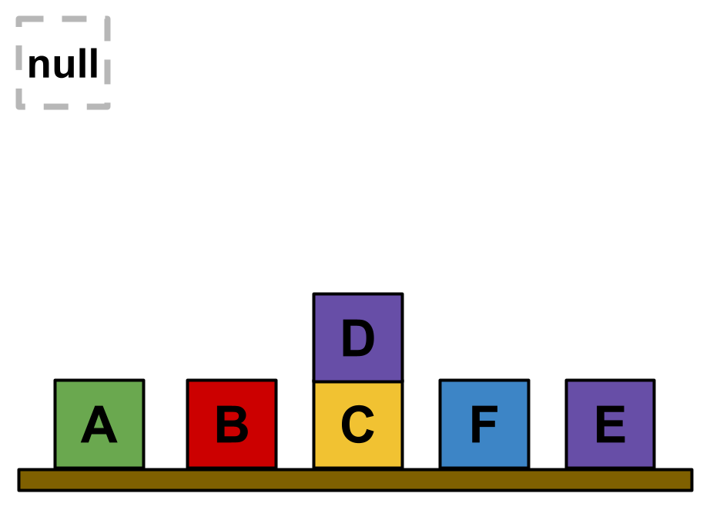
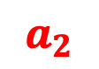
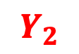
$$D_{S}$$
ColorBlocksworld
Kitchenworld
putdown E
$$a_{2}$$
IsOnTable | block | isOnTable
1 | 2 | TRUE
2 | 3 | TRUE
3 | 4 | TRUE
4 | 5 | FALSE
5 | 6 | TRUE
6 | 7 | TRUE
IsClear | block | isClear
1 | 2 | TRUE
2 | 3 | TRUE
3 | 4 | FALSE
4 | 5 | TRUE
5 | 6 | TRUE
6 | 7 | TRUE
HasColor | block | hasColor
1 | 2 | green
2 | 3 | red
3 | 4 | yellow
4 | 5 | purple
5 | 6 | purple
6 | 7 | blue
HasLabel | block | hasLabel
1 | 1 | null
2 | 2 | A
3 | 3 | B
4 | 4 | C
5 | 5 | D
6 | 6 | E
7 | 7 | F
Empty | isEmpty
1 | 1
Gripper | isHolding
1 | 1
On | on_l | on_r
1 | 5 | 4
$$Y_{2}$$

Slide 4
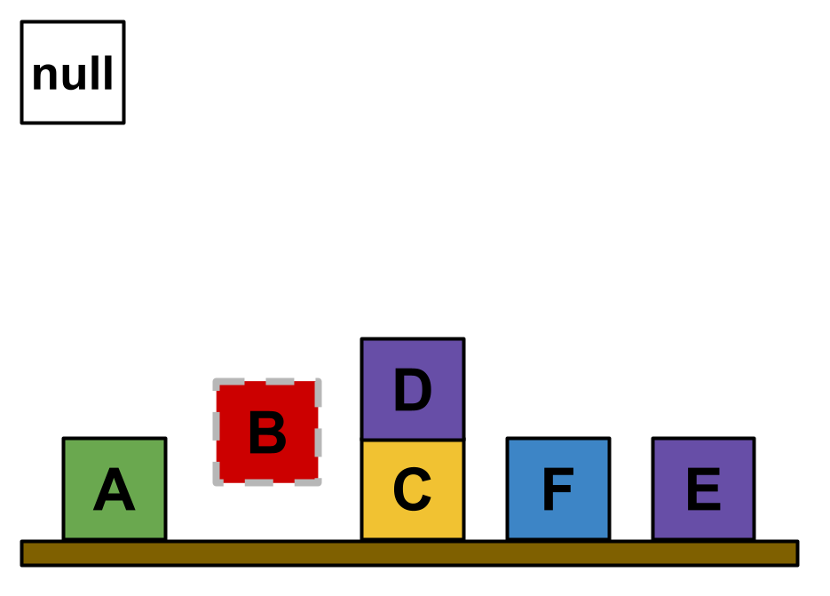
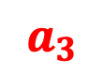
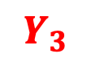
$$D_{S}$$
ColorBlocksworld
Kitchenworld
pickup B
$$a_{3}$$
IsOnTable | block | isOnTable
1 | 2 | TRUE
2 | 3 | FALSE
3 | 4 | TRUE
4 | 5 | FALSE
5 | 6 | TRUE
6 | 7 | TRUE
IsClear | block | isClear
1 | 2 | TRUE
2 | 3 | TRUE
3 | 4 | FALSE
4 | 5 | TRUE
5 | 6 | TRUE
6 | 7 | TRUE
HasColor | block | hasColor
1 | 2 | green
2 | 3 | red
3 | 4 | yellow
4 | 5 | purple
5 | 6 | purple
6 | 7 | blue
HasLabel | block | hasLabel
1 | 1 | null
2 | 2 | A
3 | 3 | B
4 | 4 | C
5 | 5 | D
6 | 6 | E
7 | 7 | F
Empty | isEmpty
1 | 1
Gripper | isHolding
1 | 3
On | on_l | on_r
1 | 5 | 4
$$Y_{3}$$

Slide 5
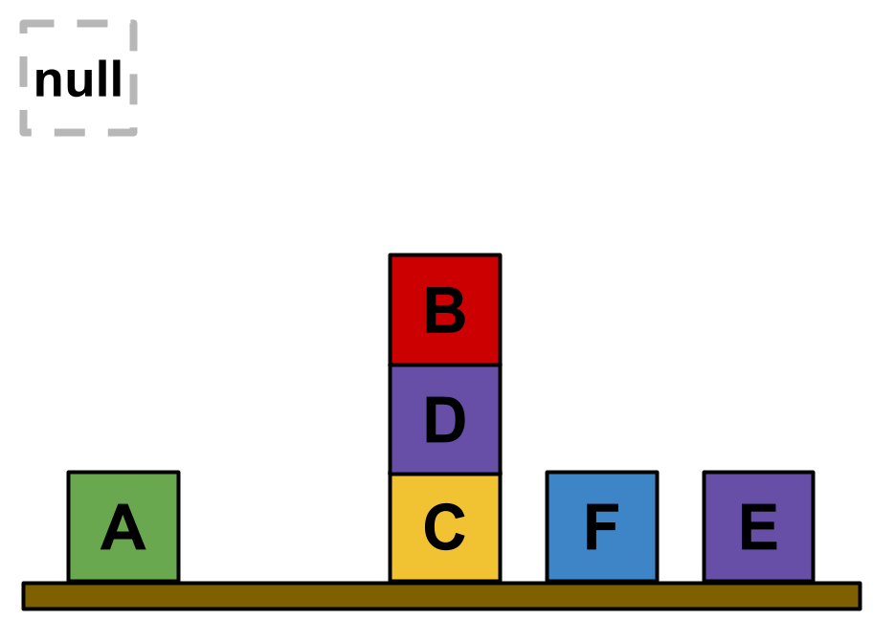
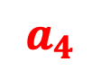
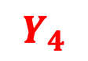
$$D_{S}$$
ColorBlocksworld
Kitchenworld
stack B D
$$a_{4}$$
IsOnTable | block | isOnTable
1 | 2 | TRUE
2 | 3 | FALSE
3 | 4 | TRUE
4 | 5 | FALSE
5 | 6 | TRUE
6 | 7 | TRUE
IsClear | block | isClear
1 | 2 | TRUE
2 | 3 | TRUE
3 | 4 | FALSE
4 | 5 | FALSE
5 | 6 | TRUE
6 | 7 | TRUE
HasColor | block | hasColor
1 | 2 | green
2 | 3 | red
3 | 4 | yellow
4 | 5 | purple
5 | 6 | purple
6 | 7 | blue
HasLabel | block | hasLabel
1 | 1 | null
2 | 2 | A
3 | 3 | B
4 | 4 | C
5 | 5 | D
6 | 6 | E
7 | 7 | F
Empty | isEmpty
1 | 1
Gripper | isHolding
1 | 1
On | on_l | on_r
1 | 5 | 4
2 | 3 | 5
$$Y_{4}$$

Slide 6
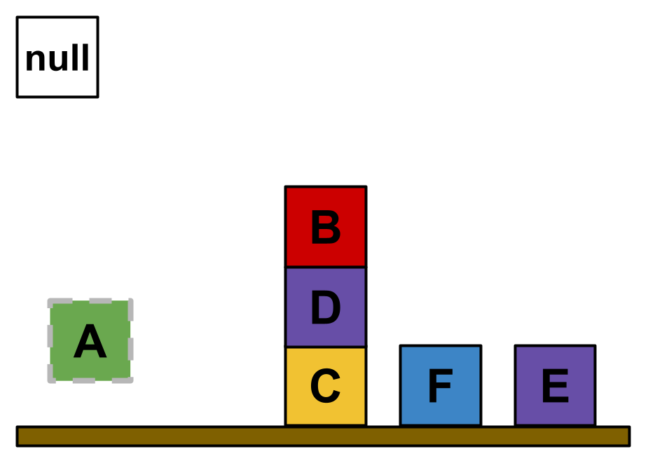
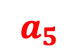
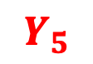
$$D_{S}$$
ColorBlocksworld
Kitchenworld
pickup A
$$a_{5}$$
IsOnTable | block | isOnTable
1 | 2 | FALSE
2 | 3 | FALSE
3 | 4 | TRUE
4 | 5 | FALSE
5 | 6 | TRUE
6 | 7 | TRUE
IsClear | block | isClear
1 | 2 | TRUE
2 | 3 | TRUE
3 | 4 | FALSE
4 | 5 | FALSE
5 | 6 | TRUE
6 | 7 | TRUE
HasColor | block | hasColor
1 | 2 | green
2 | 3 | red
3 | 4 | yellow
4 | 5 | purple
5 | 6 | purple
6 | 7 | blue
HasLabel | block | hasLabel
1 | 1 | null
2 | 2 | A
3 | 3 | B
4 | 4 | C
5 | 5 | D
6 | 6 | E
7 | 7 | F
Empty | isEmpty
1 | 1
Gripper | isHolding
1 | 2
On | on_l | on_r
1 | 5 | 4
2 | 3 | 5
$$Y_{5}$$

Slide 7
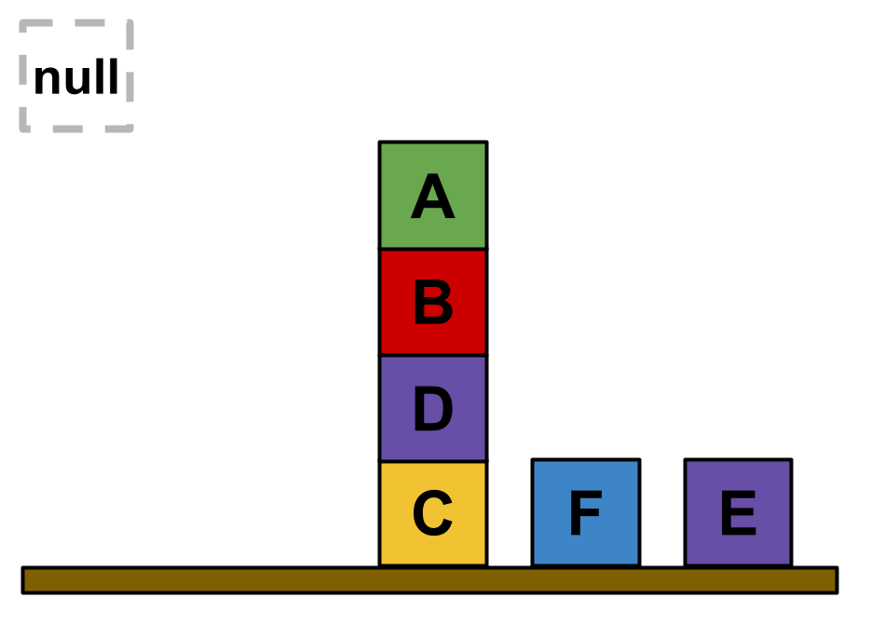
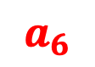
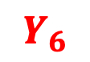
$$D_{S}$$
ColorBlocksworld
Kitchenworld
stack A B
$$a_{6}$$
IsOnTable | block | isOnTable
1 | 2 | FALSE
2 | 3 | FALSE
3 | 4 | TRUE
4 | 5 | FALSE
5 | 6 | TRUE
6 | 7 | TRUE
IsClear | block | isClear
1 | 2 | TRUE
2 | 3 | FALSE
3 | 4 | FALSE
4 | 5 | FALSE
5 | 6 | TRUE
6 | 7 | TRUE
HasColor | block | hasColor
1 | 2 | green
2 | 3 | red
3 | 4 | yellow
4 | 5 | purple
5 | 6 | purple
6 | 7 | blue
HasLabel | block | hasLabel
1 | 1 | null
2 | 2 | A
3 | 3 | B
4 | 4 | C
5 | 5 | D
6 | 6 | E
7 | 7 | F
Empty | isEmpty
1 | 1
Gripper | isHolding
1 | 1
On | on_l | on_r
1 | 5 | 4
2 | 3 | 5
3 | 2 | 3
$$Y_{6}$$

Slide 8
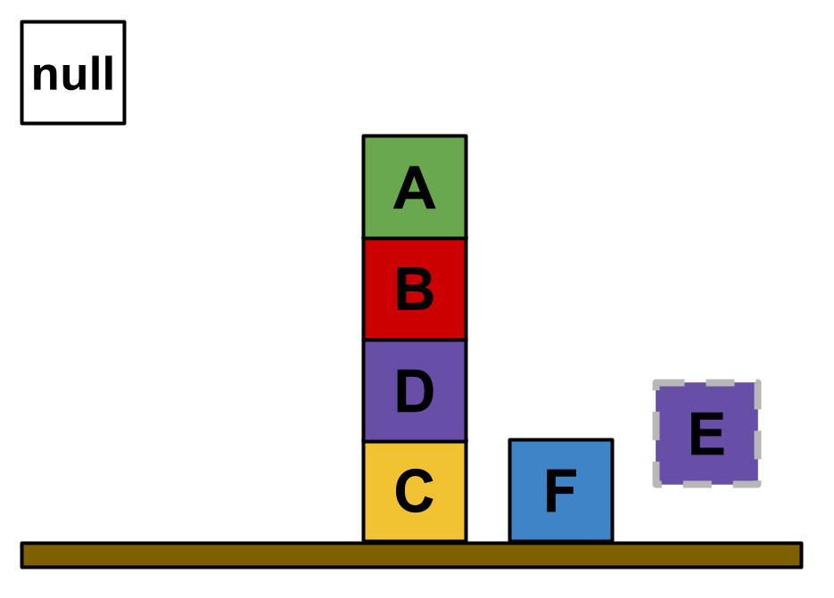
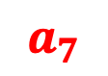
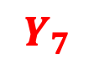
$$D_{S}$$
ColorBlocksworld
Kitchenworld
pickup E
$$a_{7}$$
IsOnTable | block | isOnTable
1 | 2 | FALSE
2 | 3 | FALSE
3 | 4 | TRUE
4 | 5 | FALSE
5 | 6 | FALSE
6 | 7 | TRUE
IsClear | block | isClear
1 | 2 | TRUE
2 | 3 | FALSE
3 | 4 | FALSE
4 | 5 | FALSE
5 | 6 | TRUE
6 | 7 | TRUE
HasColor | block | hasColor
1 | 2 | green
2 | 3 | red
3 | 4 | yellow
4 | 5 | purple
5 | 6 | purple
6 | 7 | blue
HasLabel | block | hasLabel
1 | 1 | null
2 | 2 | A
3 | 3 | B
4 | 4 | C
5 | 5 | D
6 | 6 | E
7 | 7 | F
Empty | isEmpty
1 | 1
Gripper | isHolding
1 | 6
On | on_l | on_r
1 | 5 | 4
2 | 3 | 5
3 | 2 | 3
$$Y_{7}$$

Slide 9
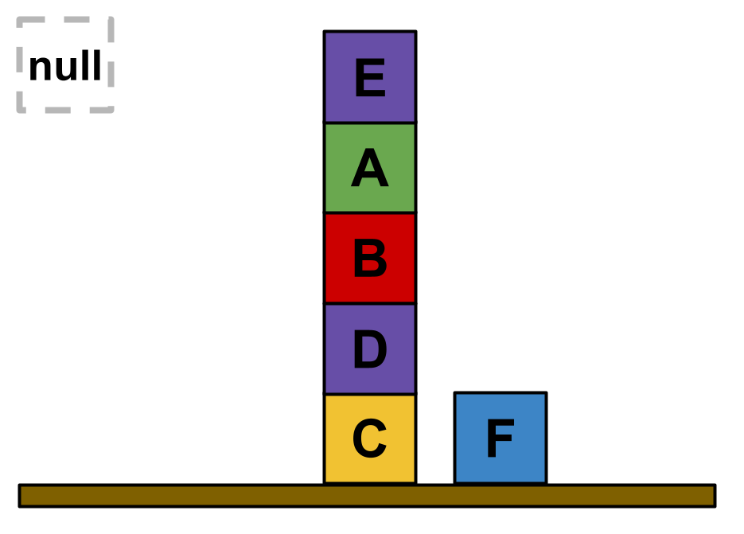
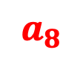
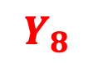
$$D_{S}$$
ColorBlocksworld
Kitchenworld
stack E A
$$a_{8}$$
IsOnTable | block | isOnTable
1 | 2 | FALSE
2 | 3 | FALSE
3 | 4 | TRUE
4 | 5 | FALSE
5 | 6 | FALSE
6 | 7 | TRUE
IsClear | block | isClear
1 | 2 | FALSE
2 | 3 | FALSE
3 | 4 | FALSE
4 | 5 | FALSE
5 | 6 | TRUE
6 | 7 | TRUE
HasColor | block | hasColor
1 | 2 | green
2 | 3 | red
3 | 4 | yellow
4 | 5 | purple
5 | 6 | purple
6 | 7 | blue
HasLabel | block | hasLabel
1 | 1 | null
2 | 2 | A
3 | 3 | B
4 | 4 | C
5 | 5 | D
6 | 6 | E
7 | 7 | F
Empty | isEmpty
1 | 1
Gripper | isHolding
1 | 1
On | on_l | on_r
1 | 5 | 4
2 | 3 | 5
3 | 2 | 3
4 | 6 | 2
$$Y_{8}$$

Slide 10
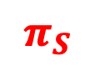
$$D_{S}$$
ColorBlocksworld
Kitchenworld
$$π_{S}$$
IsOnTable | block | isOnTable
1 | 2 | FALSE
2 | 3 | FALSE
3 | 4 | TRUE
4 | 5 | FALSE
5 | 6 | FALSE
6 | 7 | TRUE
IsClear | block | isClear
1 | 2 | FALSE
2 | 3 | FALSE
3 | 4 | FALSE
4 | 5 | FALSE
5 | 6 | TRUE
6 | 7 | TRUE
HasColor | block | hasColor
1 | 2 | green
2 | 3 | red
3 | 4 | yellow
4 | 5 | purple
5 | 6 | purple
6 | 7 | blue
HasLabel | block | hasLabel
1 | 1 | null
2 | 2 | A
3 | 3 | B
4 | 4 | C
5 | 5 | D
6 | 6 | E
7 | 7 | F
Empty | isEmpty
1 | 1
Gripper | isHolding
1 | 1
On | on_l | on_r
1 | 5 | 4
2 | 3 | 5
3 | 2 | 3
4 | 6 | 2
$$Y_{8}$$

Slide 11

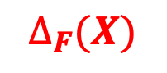
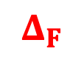
$$D_{S}$$
ColorBlocksworld
Kitchenworld
$$D_{T}$$
$$Δ_{F}$$
$$π_{S}$$
IsOnTable | block | isOnTable
1 | 2 | FALSE
2 | 3 | FALSE
3 | 4 | TRUE
4 | 5 | FALSE
5 | 6 | FALSE
6 | 7 | TRUE
IsClear | block | isClear
1 | 2 | FALSE
2 | 3 | FALSE
3 | 4 | FALSE
4 | 5 | FALSE
5 | 6 | TRUE
6 | 7 | TRUE
LettuceSliced | IsObject | IsReceptacle | HasTemperature | HasMass | HasMaterials
1 | 2 | 2 | 0 | 0 | Unknown
TomatoSliced | IsObject | IsReceptacle | HasTemperature | HasMass | HasMaterials
1 | 3 | 3 | 0 | 0 | Unknown
Plate | IsObject | IsReceptacle | HasTemperature | HasMass | HasMaterials
1 | 4 | 4 | 0 | 0 | Unknown
HasColor | block | hasColor
1 | 2 | green
2 | 3 | red
3 | 4 | yellow
4 | 5 | purple
5 | 6 | purple
6 | 7 | blue
HasLabel | block | hasLabel
1 | 1 | null
2 | 2 | A
3 | 3 | B
4 | 4 | C
5 | 5 | D
6 | 6 | E
7 | 7 | F
BreadSliced | IsObject | IsReceptacle | HasTemperature | HasMass | HasMaterials
1 | 5 | 5 | 0 | 0 | Unknown
2 | 6 | 6 | 0 | 0 | Unknown
Knife | IsObject | HasTemperature | HasMass | HasMaterials
1 | 7 | 0 | 0 | Unknown
Empty | isEmpty
1 | 1
Gripper | isHolding
1 | 1
Empty | isEmpty
1 | 1
Gripper | isHolding
1 | 1
On | on_l | on_r
1 | 5 | 4
2 | 3 | 5
3 | 2 | 3
4 | 6 | 2
$$Y_{8}$$
$$∆_{F}(X)$$
InReceptacle | inReceptacle_l | inReceptacle_r
1 | 6 | 5
2 | 5 | 4

Slide 12
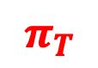
$$D_{S}$$
ColorBlocksworld
Kitchenworld
$$D_{T}$$
$$Δ_{F}$$
$$π_{S}$$
$$π_{T}$$
IsOnTable | block | isOnTable
1 | 2 | FALSE
2 | 3 | FALSE
3 | 4 | TRUE
4 | 5 | FALSE
5 | 6 | FALSE
6 | 7 | TRUE
IsClear | block | isClear
1 | 2 | FALSE
2 | 3 | FALSE
3 | 4 | FALSE
4 | 5 | FALSE
5 | 6 | TRUE
6 | 7 | TRUE
LettuceSliced | IsObject | IsReceptacle | HasTemperature | HasMass | HasMaterials
1 | 2 | 2 | 0 | 0 | Unknown
TomatoSliced | IsObject | IsReceptacle | HasTemperature | HasMass | HasMaterials
1 | 3 | 3 | 0 | 0 | Unknown
Plate | IsObject | IsReceptacle | HasTemperature | HasMass | HasMaterials
1 | 4 | 4 | 0 | 0 | Unknown
HasColor | block | hasColor
1 | 2 | green
2 | 3 | red
3 | 4 | yellow
4 | 5 | purple
5 | 6 | purple
6 | 7 | blue
HasLabel | block | hasLabel
1 | 1 | null
2 | 2 | A
3 | 3 | B
4 | 4 | C
5 | 5 | D
6 | 6 | E
7 | 7 | F
BreadSliced | IsObject | IsReceptacle | HasTemperature | HasMass | HasMaterials
1 | 5 | 5 | 0 | 0 | Unknown
2 | 6 | 6 | 0 | 0 | Unknown
Knife | IsObject | HasTemperature | HasMass | HasMaterials
1 | 7 | 0 | 0 | Unknown
Empty | isEmpty
1 | 1
Gripper | isHolding
1 | 1
Empty | isEmpty
1 | 1
Gripper | isHolding
1 | 1
On | on_l | on_r
1 | 5 | 4
2 | 3 | 5
3 | 2 | 3
4 | 6 | 2
$$Y_{8}$$
$$∆_{F}(X)$$
InReceptacle | inReceptacle_l | inReceptacle_r
1 | 6 | 5
2 | 5 | 4

Slide 13
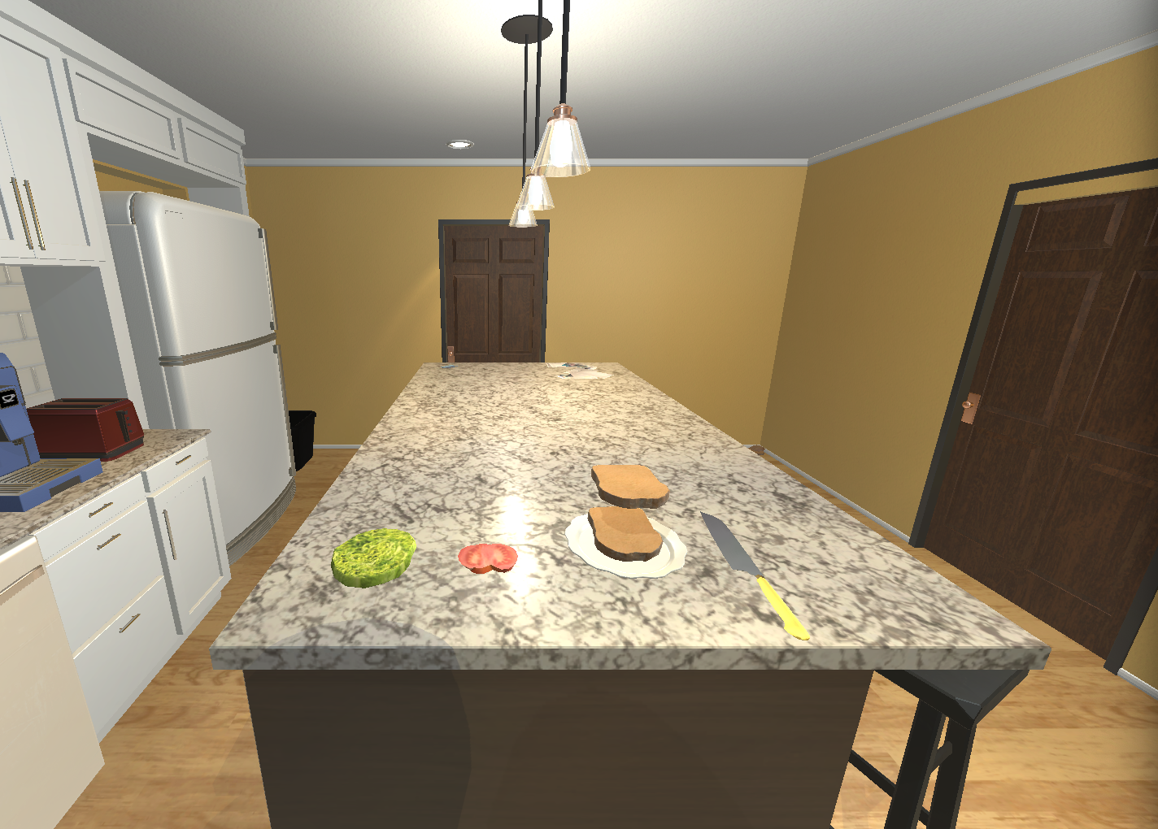
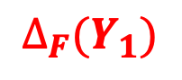
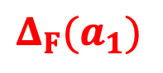
$$D_{S}$$
ColorBlocksworld
Kitchenworld
$$D_{T}$$
$${Δ_{F}(a}_{1})$$
unstack E D
$$Δ_{F}$$
$$π_{S}$$
$$π_{T}$$
IsOnTable | block | isOnTable
1 | 2 | FALSE
2 | 3 | FALSE
3 | 4 | TRUE
4 | 5 | FALSE
5 | 6 | FALSE
6 | 7 | TRUE
IsClear | block | isClear
1 | 2 | FALSE
2 | 3 | FALSE
3 | 4 | FALSE
4 | 5 | FALSE
5 | 6 | TRUE
6 | 7 | TRUE
LettuceSliced | IsObject | IsReceptacle | HasTemperature | HasMass | HasMaterials
1 | 2 | 2 | 0 | 0 | Unknown
TomatoSliced | IsObject | IsReceptacle | HasTemperature | HasMass | HasMaterials
1 | 3 | 3 | 0 | 0 | Unknown
Plate | IsObject | IsReceptacle | HasTemperature | HasMass | HasMaterials
1 | 4 | 4 | 0 | 0 | Unknown
HasColor | block | hasColor
1 | 2 | green
2 | 3 | red
3 | 4 | yellow
4 | 5 | purple
5 | 6 | purple
6 | 7 | blue
HasLabel | block | hasLabel
1 | 1 | null
2 | 2 | A
3 | 3 | B
4 | 4 | C
5 | 5 | D
6 | 6 | E
7 | 7 | F
BreadSliced | IsObject | IsReceptacle | HasTemperature | HasMass | HasMaterials
1 | 5 | 5 | 0 | 0 | Unknown
2 | 6 | 6 | 0 | 0 | Unknown
Knife | IsObject | HasTemperature | HasMass | HasMaterials
1 | 7 | 0 | 0 | Unknown
Empty | isEmpty
1 | 1
Gripper | isHolding
1 | 6
Empty | isEmpty
1 | 1
Gripper | isHolding
1 | 1
On | on_l | on_r
1 | 5 | 4
2 | 3 | 5
3 | 2 | 3
4 | 6 | 2
$$Y_{8}$$
$$∆_{F}(Y_{1})$$
InReceptacle | inReceptacle_l | inReceptacle_r
1 | 5 | 4

Slide 14

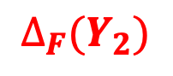
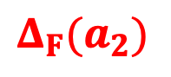
$$D_{S}$$
ColorBlocksworld
Kitchenworld
$$D_{T}$$
$${Δ_{F}(a}_{2})$$
putdown E
$$Δ_{F}$$
$$π_{S}$$
$$π_{T}$$
IsOnTable | block | isOnTable
1 | 2 | FALSE
2 | 3 | FALSE
3 | 4 | TRUE
4 | 5 | FALSE
5 | 6 | FALSE
6 | 7 | TRUE
IsClear | block | isClear
1 | 2 | FALSE
2 | 3 | FALSE
3 | 4 | FALSE
4 | 5 | FALSE
5 | 6 | TRUE
6 | 7 | TRUE
LettuceSliced | IsObject | IsReceptacle | HasTemperature | HasMass | HasMaterials
1 | 2 | 2 | 0 | 0 | Unknown
TomatoSliced | IsObject | IsReceptacle | HasTemperature | HasMass | HasMaterials
1 | 3 | 3 | 0 | 0 | Unknown
Plate | IsObject | IsReceptacle | HasTemperature | HasMass | HasMaterials
1 | 4 | 4 | 0 | 0 | Unknown
HasColor | block | hasColor
1 | 2 | green
2 | 3 | red
3 | 4 | yellow
4 | 5 | purple
5 | 6 | purple
6 | 7 | blue
HasLabel | block | hasLabel
1 | 1 | null
2 | 2 | A
3 | 3 | B
4 | 4 | C
5 | 5 | D
6 | 6 | E
7 | 7 | F
BreadSliced | IsObject | IsReceptacle | HasTemperature | HasMass | HasMaterials
1 | 5 | 5 | 0 | 0 | Unknown
2 | 6 | 6 | 0 | 0 | Unknown
Knife | IsObject | HasTemperature | HasMass | HasMaterials
1 | 7 | 0 | 0 | Unknown
Empty | isEmpty
1 | 1
Gripper | isHolding
1 | 1
Empty | isEmpty
1 | 1
Gripper | isHolding
1 | 1
On | on_l | on_r
1 | 5 | 4
2 | 3 | 5
3 | 2 | 3
4 | 6 | 2
$$Y_{8}$$
$$∆_{F}(Y_{2})$$
InReceptacle | inReceptacle_l | inReceptacle_r
1 | 5 | 4

Slide 15
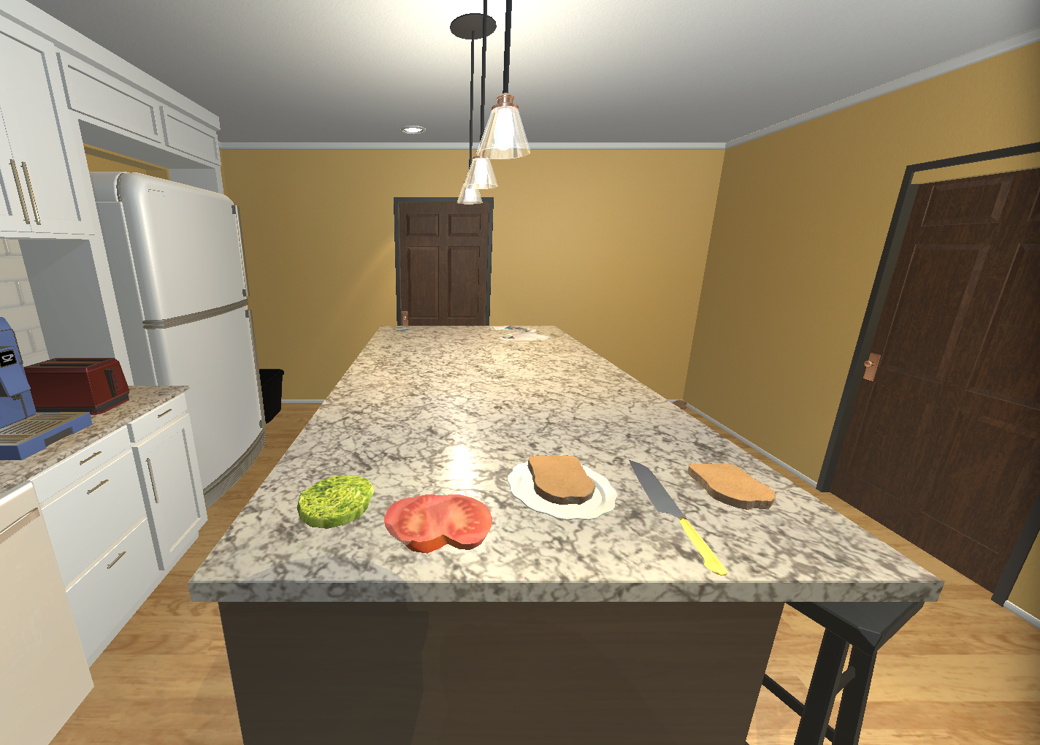

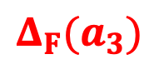
$$D_{S}$$
ColorBlocksworld
Kitchenworld
$$D_{T}$$
$${Δ_{F}(a}_{3})$$
pickup B
$$Δ_{F}$$
$$π_{S}$$
$$π_{T}$$
IsOnTable | block | isOnTable
1 | 2 | FALSE
2 | 3 | FALSE
3 | 4 | TRUE
4 | 5 | FALSE
5 | 6 | FALSE
6 | 7 | TRUE
IsClear | block | isClear
1 | 2 | FALSE
2 | 3 | FALSE
3 | 4 | FALSE
4 | 5 | FALSE
5 | 6 | TRUE
6 | 7 | TRUE
LettuceSliced | IsObject | IsReceptacle | HasTemperature | HasMass | HasMaterials
1 | 2 | 2 | 0 | 0 | Unknown
TomatoSliced | IsObject | IsReceptacle | HasTemperature | HasMass | HasMaterials
1 | 3 | 3 | 0 | 0 | Unknown
Plate | IsObject | IsReceptacle | HasTemperature | HasMass | HasMaterials
1 | 4 | 4 | 0 | 0 | Unknown
HasColor | block | hasColor
1 | 2 | green
2 | 3 | red
3 | 4 | yellow
4 | 5 | purple
5 | 6 | purple
6 | 7 | blue
HasLabel | block | hasLabel
1 | 1 | null
2 | 2 | A
3 | 3 | B
4 | 4 | C
5 | 5 | D
6 | 6 | E
7 | 7 | F
BreadSliced | IsObject | IsReceptacle | HasTemperature | HasMass | HasMaterials
1 | 5 | 5 | 0 | 0 | Unknown
2 | 6 | 6 | 0 | 0 | Unknown
Knife | IsObject | HasTemperature | HasMass | HasMaterials
1 | 7 | 0 | 0 | Unknown
Empty | isEmpty
1 | 1
Gripper | isHolding
1 | 3
Empty | isEmpty
1 | 1
Gripper | isHolding
1 | 1
On | on_l | on_r
1 | 5 | 4
2 | 3 | 5
3 | 2 | 3
4 | 6 | 2
$$Y_{8}$$
$$∆_{F}(Y_{3})$$
InReceptacle | inReceptacle_l | inReceptacle_r
1 | 5 | 4

Slide 16

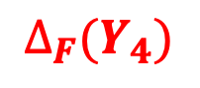
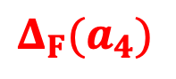
$$D_{S}$$
ColorBlocksworld
Kitchenworld
$$D_{T}$$
$${Δ_{F}(a}_{4})$$
stack B D
$$Δ_{F}$$
$$π_{S}$$
$$π_{T}$$
IsOnTable | block | isOnTable
1 | 2 | FALSE
2 | 3 | FALSE
3 | 4 | TRUE
4 | 5 | FALSE
5 | 6 | FALSE
6 | 7 | TRUE
IsClear | block | isClear
1 | 2 | FALSE
2 | 3 | FALSE
3 | 4 | FALSE
4 | 5 | FALSE
5 | 6 | TRUE
6 | 7 | TRUE
LettuceSliced | IsObject | IsReceptacle | HasTemperature | HasMass | HasMaterials
1 | 2 | 2 | 0 | 0 | Unknown
TomatoSliced | IsObject | IsReceptacle | HasTemperature | HasMass | HasMaterials
1 | 3 | 3 | 0 | 0 | Unknown
Plate | IsObject | IsReceptacle | HasTemperature | HasMass | HasMaterials
1 | 4 | 4 | 0 | 0 | Unknown
HasColor | block | hasColor
1 | 2 | green
2 | 3 | red
3 | 4 | yellow
4 | 5 | purple
5 | 6 | purple
6 | 7 | blue
HasLabel | block | hasLabel
1 | 1 | null
2 | 2 | A
3 | 3 | B
4 | 4 | C
5 | 5 | D
6 | 6 | E
7 | 7 | F
BreadSliced | IsObject | IsReceptacle | HasTemperature | HasMass | HasMaterials
1 | 5 | 5 | 0 | 0 | Unknown
2 | 6 | 6 | 0 | 0 | Unknown
Knife | IsObject | HasTemperature | HasMass | HasMaterials
1 | 7 | 0 | 0 | Unknown
Empty | isEmpty
1 | 1
Gripper | isHolding
1 | 1
Empty | isEmpty
1 | 1
Gripper | isHolding
1 | 1
On | on_l | on_r
1 | 5 | 4
2 | 3 | 5
3 | 2 | 3
4 | 6 | 2
$$Y_{8}$$
$$∆_{F}(Y_{4})$$
InReceptacle | inReceptacle_l | inReceptacle_r
1 | 5 | 4
2 | 3 | 5

Slide 17
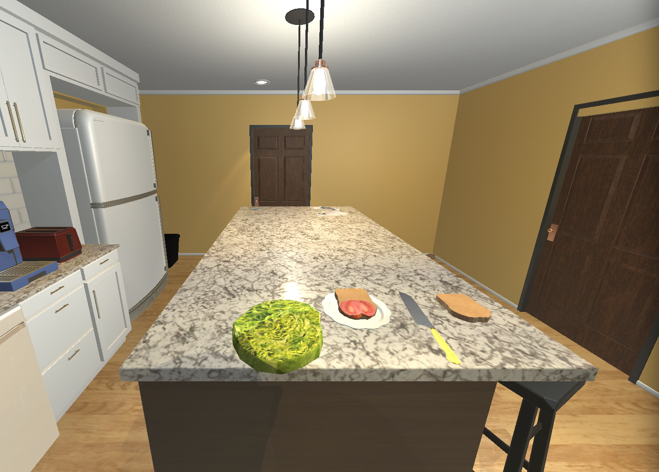


$$D_{S}$$
ColorBlocksworld
Kitchenworld
$$D_{T}$$
$${Δ_{F}(a}_{5})$$
pickup A
$$Δ_{F}$$
$$π_{S}$$
$$π_{T}$$
IsOnTable | block | isOnTable
1 | 2 | FALSE
2 | 3 | FALSE
3 | 4 | TRUE
4 | 5 | FALSE
5 | 6 | FALSE
6 | 7 | TRUE
IsClear | block | isClear
1 | 2 | FALSE
2 | 3 | FALSE
3 | 4 | FALSE
4 | 5 | FALSE
5 | 6 | TRUE
6 | 7 | TRUE
LettuceSliced | IsObject | IsReceptacle | HasTemperature | HasMass | HasMaterials
1 | 2 | 2 | 0 | 0 | Unknown
TomatoSliced | IsObject | IsReceptacle | HasTemperature | HasMass | HasMaterials
1 | 3 | 3 | 0 | 0 | Unknown
Plate | IsObject | IsReceptacle | HasTemperature | HasMass | HasMaterials
1 | 4 | 4 | 0 | 0 | Unknown
HasColor | block | hasColor
1 | 2 | green
2 | 3 | red
3 | 4 | yellow
4 | 5 | purple
5 | 6 | purple
6 | 7 | blue
HasLabel | block | hasLabel
1 | 1 | null
2 | 2 | A
3 | 3 | B
4 | 4 | C
5 | 5 | D
6 | 6 | E
7 | 7 | F
BreadSliced | IsObject | IsReceptacle | HasTemperature | HasMass | HasMaterials
1 | 5 | 5 | 0 | 0 | Unknown
2 | 6 | 6 | 0 | 0 | Unknown
Knife | IsObject | HasTemperature | HasMass | HasMaterials
1 | 7 | 0 | 0 | Unknown
Empty | isEmpty
1 | 1
Gripper | isHolding
1 | 2
Empty | isEmpty
1 | 1
Gripper | isHolding
1 | 1
On | on_l | on_r
1 | 5 | 4
2 | 3 | 5
3 | 2 | 3
4 | 6 | 2
$$Y_{8}$$
$$∆_{F}(Y_{5})$$
InReceptacle | inReceptacle_l | inReceptacle_r
1 | 5 | 4
2 | 3 | 5

Slide 18
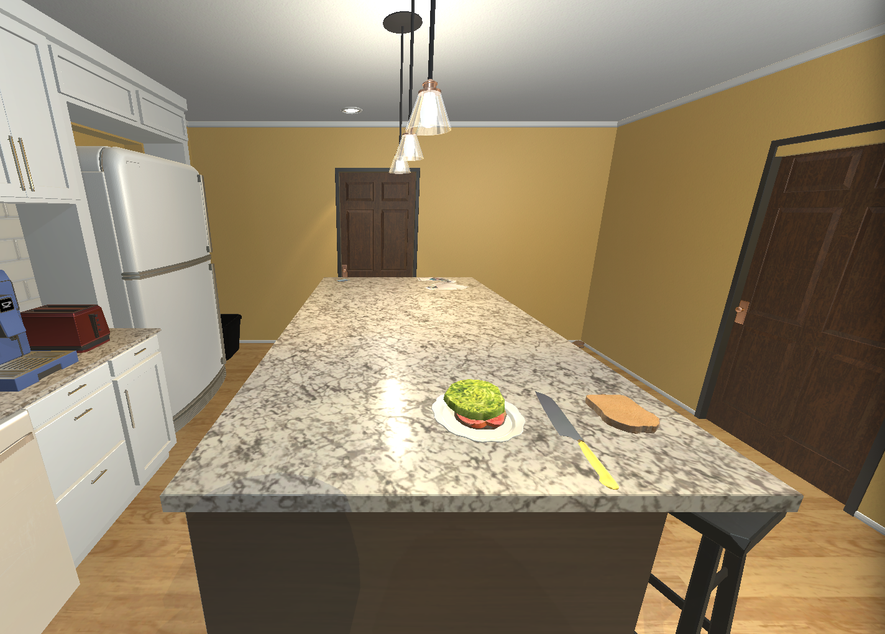
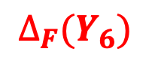

$$D_{S}$$
ColorBlocksworld
Kitchenworld
$$D_{T}$$
$${Δ_{F}(a}_{6})$$
stack A B
$$Δ_{F}$$
$$π_{S}$$
$$π_{T}$$
IsOnTable | block | isOnTable
1 | 2 | FALSE
2 | 3 | FALSE
3 | 4 | TRUE
4 | 5 | FALSE
5 | 6 | FALSE
6 | 7 | TRUE
IsClear | block | isClear
1 | 2 | FALSE
2 | 3 | FALSE
3 | 4 | FALSE
4 | 5 | FALSE
5 | 6 | TRUE
6 | 7 | TRUE
LettuceSliced | IsObject | IsReceptacle | HasTemperature | HasMass | HasMaterials
1 | 2 | 2 | 0 | 0 | Unknown
TomatoSliced | IsObject | IsReceptacle | HasTemperature | HasMass | HasMaterials
1 | 3 | 3 | 0 | 0 | Unknown
Plate | IsObject | IsReceptacle | HasTemperature | HasMass | HasMaterials
1 | 4 | 4 | 0 | 0 | Unknown
HasColor | block | hasColor
1 | 2 | green
2 | 3 | red
3 | 4 | yellow
4 | 5 | purple
5 | 6 | purple
6 | 7 | blue
HasLabel | block | hasLabel
1 | 1 | null
2 | 2 | A
3 | 3 | B
4 | 4 | C
5 | 5 | D
6 | 6 | E
7 | 7 | F
BreadSliced | IsObject | IsReceptacle | HasTemperature | HasMass | HasMaterials
1 | 5 | 5 | 0 | 0 | Unknown
2 | 6 | 6 | 0 | 0 | Unknown
Knife | IsObject | HasTemperature | HasMass | HasMaterials
1 | 7 | 0 | 0 | Unknown
Empty | isEmpty
1 | 1
Gripper | isHolding
1 | 1
Empty | isEmpty
1 | 1
Gripper | isHolding
1 | 1
On | on_l | on_r
1 | 5 | 4
2 | 3 | 5
3 | 2 | 3
4 | 6 | 2
$$Y_{8}$$
$$∆_{F}(Y_{6})$$
InReceptacle | inReceptacle_l | inReceptacle_r
1 | 5 | 4
2 | 3 | 5
3 | 2 | 3

Slide 19
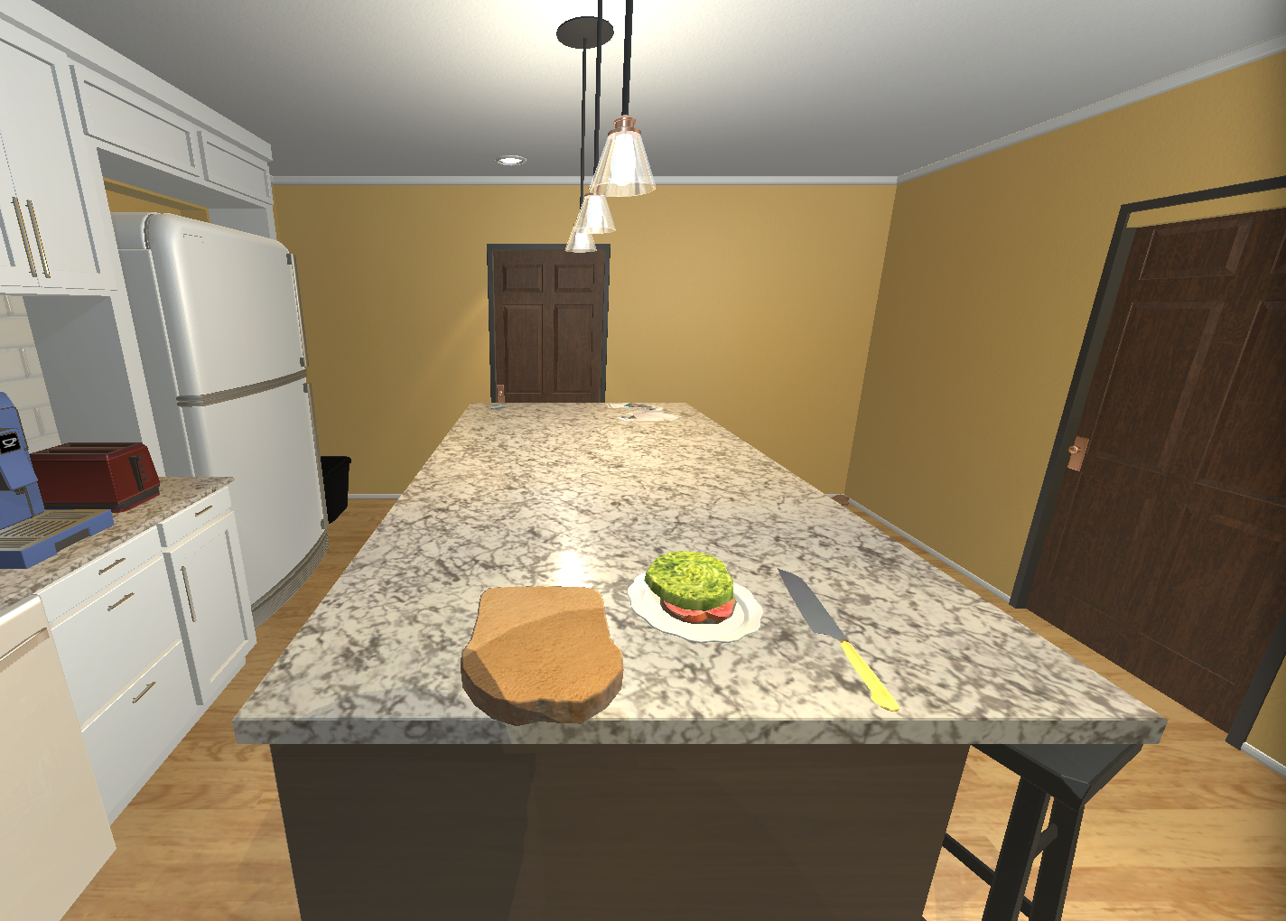
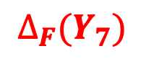
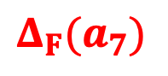
$$D_{S}$$
ColorBlocksworld
Kitchenworld
$$D_{T}$$
$${Δ_{F}(a}_{7})$$
pickup E
$$Δ_{F}$$
$$π_{S}$$
$$π_{T}$$
IsOnTable | block | isOnTable
1 | 2 | FALSE
2 | 3 | FALSE
3 | 4 | TRUE
4 | 5 | FALSE
5 | 6 | FALSE
6 | 7 | TRUE
IsClear | block | isClear
1 | 2 | FALSE
2 | 3 | FALSE
3 | 4 | FALSE
4 | 5 | FALSE
5 | 6 | TRUE
6 | 7 | TRUE
LettuceSliced | IsObject | IsReceptacle | HasTemperature | HasMass | HasMaterials
1 | 2 | 2 | 0 | 0 | Unknown
TomatoSliced | IsObject | IsReceptacle | HasTemperature | HasMass | HasMaterials
1 | 3 | 3 | 0 | 0 | Unknown
Plate | IsObject | IsReceptacle | HasTemperature | HasMass | HasMaterials
1 | 4 | 4 | 0 | 0 | Unknown
HasColor | block | hasColor
1 | 2 | green
2 | 3 | red
3 | 4 | yellow
4 | 5 | purple
5 | 6 | purple
6 | 7 | blue
HasLabel | block | hasLabel
1 | 1 | null
2 | 2 | A
3 | 3 | B
4 | 4 | C
5 | 5 | D
6 | 6 | E
7 | 7 | F
BreadSliced | IsObject | IsReceptacle | HasTemperature | HasMass | HasMaterials
1 | 5 | 5 | 0 | 0 | Unknown
2 | 6 | 6 | 0 | 0 | Unknown
Knife | IsObject | HasTemperature | HasMass | HasMaterials
1 | 7 | 0 | 0 | Unknown
Empty | isEmpty
1 | 1
Gripper | isHolding
1 | 6
Empty | isEmpty
1 | 1
Gripper | isHolding
1 | 1
On | on_l | on_r
1 | 5 | 4
2 | 3 | 5
3 | 2 | 3
4 | 6 | 2
$$Y_{8}$$
$$∆_{F}(Y_{7})$$
InReceptacle | inReceptacle_l | inReceptacle_r
1 | 5 | 4
2 | 3 | 5
3 | 2 | 3

Slide 20

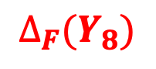
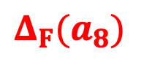
$$D_{S}$$
ColorBlocksworld
Kitchenworld
$$D_{T}$$
$${Δ_{F}(a}_{8})$$
stack E A
$$Δ_{F}$$
$$π_{S}$$
$$π_{T}$$
IsOnTable | block | isOnTable
1 | 2 | FALSE
2 | 3 | FALSE
3 | 4 | TRUE
4 | 5 | FALSE
5 | 6 | FALSE
6 | 7 | TRUE
IsClear | block | isClear
1 | 2 | FALSE
2 | 3 | FALSE
3 | 4 | FALSE
4 | 5 | FALSE
5 | 6 | TRUE
6 | 7 | TRUE
LettuceSliced | IsObject | IsReceptacle | HasTemperature | HasMass | HasMaterials
1 | 2 | 2 | 0 | 0 | Unknown
TomatoSliced | IsObject | IsReceptacle | HasTemperature | HasMass | HasMaterials
1 | 3 | 3 | 0 | 0 | Unknown
Plate | IsObject | IsReceptacle | HasTemperature | HasMass | HasMaterials
1 | 4 | 4 | 0 | 0 | Unknown
HasColor | block | hasColor
1 | 2 | green
2 | 3 | red
3 | 4 | yellow
4 | 5 | purple
5 | 6 | purple
6 | 7 | blue
HasLabel | block | hasLabel
1 | 1 | null
2 | 2 | A
3 | 3 | B
4 | 4 | C
5 | 5 | D
6 | 6 | E
7 | 7 | F
BreadSliced | IsObject | IsReceptacle | HasTemperature | HasMass | HasMaterials
1 | 5 | 5 | 0 | 0 | Unknown
2 | 6 | 6 | 0 | 0 | Unknown
Knife | IsObject | HasTemperature | HasMass | HasMaterials
1 | 7 | 0 | 0 | Unknown
Empty | isEmpty
1 | 1
Gripper | isHolding
1 | 6
Empty | isEmpty
1 | 1
Gripper | isHolding
1 | 1
On | on_l | on_r
1 | 5 | 4
2 | 3 | 5
3 | 2 | 3
4 | 6 | 2
$$Y_{8}$$
$$∆_{F}(Y_{8})$$
InReceptacle | inReceptacle_l | inReceptacle_r
1 | 5 | 4
2 | 3 | 5
3 | 2 | 3
4 | 6 | 2

Slide 21
$$D_{S}$$
ColorBlocksworld
Kitchenworld
$$D_{T}$$
$$Δ_{F}$$
$$π_{S}$$
$$π_{T}$$
IsOnTable | block | isOnTable
1 | 2 | FALSE
2 | 3 | FALSE
3 | 4 | TRUE
4 | 5 | FALSE
5 | 6 | FALSE
6 | 7 | TRUE
IsClear | block | isClear
1 | 2 | FALSE
2 | 3 | FALSE
3 | 4 | FALSE
4 | 5 | FALSE
5 | 6 | TRUE
6 | 7 | TRUE
LettuceSliced | IsObject | IsReceptacle | HasTemperature | HasMass | HasMaterials
1 | 2 | 2 | 0 | 0 | Unknown
TomatoSliced | IsObject | IsReceptacle | HasTemperature | HasMass | HasMaterials
1 | 3 | 3 | 0 | 0 | Unknown
Plate | IsObject | IsReceptacle | HasTemperature | HasMass | HasMaterials
1 | 4 | 4 | 0 | 0 | Unknown
HasColor | block | hasColor
1 | 2 | green
2 | 3 | red
3 | 4 | yellow
4 | 5 | purple
5 | 6 | purple
6 | 7 | blue
HasLabel | block | hasLabel
1 | 1 | null
2 | 2 | A
3 | 3 | B
4 | 4 | C
5 | 5 | D
6 | 6 | E
7 | 7 | F
BreadSliced | IsObject | IsReceptacle | HasTemperature | HasMass | HasMaterials
1 | 5 | 5 | 0 | 0 | Unknown
2 | 6 | 6 | 0 | 0 | Unknown
Knife | IsObject | HasTemperature | HasMass | HasMaterials
1 | 7 | 0 | 0 | Unknown
Empty | isEmpty
1 | 1
Gripper | isHolding
1 | 6
Empty | isEmpty
1 | 1
Gripper | isHolding
1 | 1
On | on_l | on_r
1 | 5 | 4
2 | 3 | 5
3 | 2 | 3
4 | 6 | 2
$$Y_{8}$$
$$∆_{F}(Y_{8})$$
InReceptacle | inReceptacle_l | inReceptacle_r
1 | 5 | 4
2 | 3 | 5
3 | 2 | 3
4 | 6 | 2

